Slide 1
Requirements for PhD Psychology Students
 | 1st Year | 2nd Year | 3rd Year | 4th Year | 5th Year | 6th Year
Funding/ Assistantships | Early Fellowship 6 units min load required 12 units normal load (paid by Dornsife) 16 units max load PSYC Dept. Travel Grant Awards: up to $1k PSYC Doctoral Research Grant Award: up to $4k GSG Travel Grant up to $1k, must exhaust all other funding | TA/RA Teaching Assistant: Assist in Teaching functions, such as preparing exams, scoring, registering, and instruction Research Assistant: Carry out research projects, such as implementation, design, analysis, write up Fellowship Boot Camp: $1k stipend for housing, up to $1k travel or research award | TA/RA | TA/RA | Advanced Fellowship Dissertation We discourage students from taking the final year of their fellowship till their last year. | No funding given, unless they do TA/RA (can do up to 2 years) Clinical students have internship
Deadlines of Benchmarks | First-Year Screening at the end of 1st year: Courses & Research Performance Minimum of 16 units (4 courses, 3 must be substantive units) Specialty area will evaluate research performance Area Head will notify by August 15 of passing of first-year screening (Pass/Terminal for M.A./Dismissal) Pass: B -3.0 average, One or < “C” grade, | Second Year Research Requirement due prior to end of 4th semester Master Thesis or Research report (comparable) If do not already have M.A., register for 594ab, turn in “Addition Degree Objective” form for POST 606, & submit Mather’s thesis. Otherwise can get 590 credit for research if needed. Must be approved by the evaluation committee by the end of the fourth semester and "acceptable for publication”. Send a file of the completed sign-off sheets and the approved research papers to grad advisor. 24-unit Screening: Must pass 24 units After completing second year project, discuss with advisor in formulating a guidance committee for Quals. | Graduate School Min.: 3 years of full-time studies, 1 year of internship (CL) Poster Fair In September, third year students are required to present their second-year projects or another research project as part of a departmental poster session. Meet with Graduate Advisor for Degree check and STARS Report 36 substantive units total (590,790,594,794 are not substantive units) 24 Units within PSYC 8 Courses: Category A: 8 units min 16 unit Courses: Category B: 4 units min Category C: 4 units min 12 Units anywhere else Approved AoC form must be done 6 months before quals written exam. Better to be done a year before. | Qualifying Exam due before end of 7th semester (November 30th)1 year before taking quals exam turn in Guidance Committee. Consists of a separate written and oral section that are completed sequentially. After Written is passed, oral must be scheduled within 60 days. Change of Committee form needed to change members. After Quals is passed, must appoint a dissertation committee (2 psychology member in student’s area, 1 from another area, 1 outside of dept, 3 need to be tenured-track faculty with a primary appointment in psychology -- Qualifying Exam due before end of 7th semester (3 ½ mark) Dissertation Defense: Inform Graduate Student Advisor, Setup Dissertation profile on the Graduate School Thesis Center Site. | 60 Units min for Ph.D. If have 60 units, enroll in GRSC800 up to 3 semesters. Admission to Candidacy: (a)passed dept course & screening (b) 24 unit at the university (c) passed quals exam Thesis/Dissertation Submission Deadlines: Summer: June Fall: October Spring: March
Passing of Benchmark Requirements | Min: 16 units (four courses), three must be substantive courses | 3 committee members approve work
Policies | Failing Benchmark: Lower than 3.0 GPA More than one “C” grade No more than one INC | LOA: Requires petition before add/drop deadline of request semester. Must use Petition form and contact area head. If you do not return= no longer pursuing degree. If you take more than 4 semesters, must petition with the Graduate School. |  |  | Extension of 8 years + requires petition with Graduate School, max 10 years (in rare cases only)

Slide 2
COURSES THAT FULFILL DEPARTMENT-WIDE CORE REQUIREMENTS
Category A: Statistics and Research Design Courses |  | Category B: Biological Bases of Behavior and Cognitive-Affective Bases of Behavior |  | Category C: Social Bases of Behavior & Individual Differences
500 An Overview of Quantitative Methods in Psychology 501 Statistics in Psychological Research 502 Analysis of Variance and Experimental Design 503 Regression and the General Linear Model 504 Research Design 520 Fundamentals of Psychological Measurement 524 Research Design in Developmental Psychology 575 Multivariate Analysis of Behavioral Data 577 Analysis of Covariance Structures 578 Workshop in Quantitative Methods 616 Research Techniques for Non-Experimental Social Science 621 Seminar in Quantitative Psychology 622 Decision Analysis and Behavioral Decision Theory 625 Advanced Big Data Methods |  | (physiological psychology, comparative psychology, neuropsychology, sensation and perception, psycho-pharmacology, behavior genetics) and Cognitive-Affective Bases of Behavior (learning, thinking, motivation, problem-solving). 506 Learning and Cognition 510 Visual Cognition 540 Cognitive Neuroscience 544 Psychophysiology 545 Neuropsychology 547 Functional Neuroanatomy 551 Decision Neuroscience 555 Introduction to Functional Magnetic Resonance Imaging 576 Psycholinguistics 586 Advanced Psycholinguistics 676 Seminar in Psycholinguistics |  | Social Bases of Behavior (social psychology, group processes, organizational and systems theory) and Individual Differences (personality theory, human development, abnormal psychology). 512 Seminar in Social Psychology 514 Psychopathology *515 Clinical Assessment 533 Cognitive Development in Children 538 Origins of Human Nature 534 Social and Emotional Development in Children *595 Practicum in Clinical Psychology 612 Seminar in Advanced Social Psychology *619 Psychological Intervention 626 Computational Social Sciences 660 Seminar in Clinical Psychology 680 Seminar in Psychopathology *695 Advanced Practicum in Clinical Psychology *Courses marked with an asterisk may only be taken by students in the Clinical, Clinical-Aging, Child & Family Clinical programs.
60 Units min for Ph.D. |  | 36 substantive units total (590,790,594,794 are not substantive units, TA course 593 is substantive) |  | 24 Units within PSYC
8 Courses: Category A: 8 units min *Quant Students: can substitute one additional statistics/research design course for one of the four courses required from Categories B and C, still need at least one course from Category B and one course from Category C. |  | 16 unit Courses Total Required in Category B & C: Category B: 4 units min Category C: 4 units min *Students from specialty areas other than Clinical, Clinical-Aging, and Child & Family Clinical may take no more than three clinical courses. Those taken must be from 514 and 660 unless approval is received from the clinical faculty to enroll in a course not on this list. * Students may petition to the Director of Graduate Studies to have 599s fulfill categories A, B and C.
2nd Year Project Courses: M.A .Degree: Register for 594ab (rather than 590) and submitting the report as a Master's thesis. Research Paper: Course credit (590) may be obtained for this research, at the student's and advisor's option. | After Quals are passed: Must register for 794 of a minimum of 4 units every semester (excluding summer which would be 2 units) until degree is completed. Only 8 units total of 794 can be received. |  | Internship: Clinical students register for 691 (1 non-credit unit per semester) rather than 794 during internship. Student must register for 691 or 794 during the semester when take their final oral, unless they defend in the summer. |  | If have met course requirements almost at 60 units, enroll in GRSC800 up to 3 semesters. Do not enroll in 8 units repeatedly of 790. GEAC 802

Slide 3
COURSE REQUIREMENTS
 | Area Course Requirements | Ph.D. Program Requirements Needed | Recommendations
Brain Cognitive Sciences | PSYC 500: An Overview of Quantitative Methods in Psychology or PSYC 501:Statistics in Psychological Research (Cat A) PSYC 502: Analysis of Variance and Experimental Design or PSYC 503: Regression and the General Linear Model (All Cat A) Note: If student has strong background in Stats, they can get Advisor permission to take PSYC 621 –Seminar in Quantitative Psychology- to cover both 500/501 & 502/503) | 8 Unit Courses from Category A Covered by PSYC 500/501 & PSYC 502/503 16 units Courses Required from Category B & C 1 Category B Course (4 Units min) 1 Category C Course (4 Units min) | PSYC 547: Functional Neuroanatomy or PSYC 545: Neuropsychology (Cat B) PSYC 540: Cognitive Neuroscience (Cat B)
Developmental Psychology | PSYC 500: An Overview of Quantitative Methods in Psychology (Cat A) PSYC 501: Statistics in Psychological Research (Cat A) PSYC 502: Analysis of Variance and Experimental Design, or PSYC 503:Regression and the General Linear Model or PSYC 575: Multivariate Analysis of Behavioral Data (All Cat A) Must be taken in first two years: (unless courses not offered due to faculty leave) PSYC 533: Cognitive Development in Children (Cat C) PSYC 534: Social and Emotional Development in Children (Cat C) | 8 Unit Courses from Category A Covered by PSYC 500, 501 16 units Courses Required from Category B & C 1 Category B Course (4 Units min) 1 Category C Course (4 Units min) Covered by PSYC 533, 534 *Quant Students: can substitute one additional statistics/research design course for one of the four courses required from Categories B and C, still need at least one course from Category B and one course from Category C. | PSYC 504: Research Design (Cat A) PSYC 524: Research Design in Developmental Psychology (Cat A)
Quantitative Psychology | 6 courses in Quantitative Methods from Category A list Note: Dismissal if do not have course within 5 years. One course can be substituted from another department if approval by advisor and area head. | 8 Unit Courses from Category A Covered by Area Requirement of 6 courses in Quantitative Methods 16 units Courses Required from Category B & C 1 Category B Course (4 Units min) 1 Category C Course (4 Units min)
Social Psychology | 3 courses from Category A: one must be PSYC 616 taken within first two years of study 1 Course in Category B 4 Courses in Category C: PSYC 512 taken in first year, three 600-level content seminars in social psychology (PSYC 612, taught by different professors) 1 Course in area outside of social psychology relevant to research | 8 Unit Courses from Category A Covered by Area Requirement 16 units Courses Required from Category B & C 1 Category B Course (4 Units min) Covered in Area Requirement 1 Category C Course (4 Units min) Covered in Area Requirement
Ph.D. Program Requirements for all students | 8 Courses: Category A: 8 units min 8 units is required per semester for first three semesters and is minimum load for full-time graduate students. | 16 unit Courses Total Required in Category B & C: Category B: 4 units min Category C: 4 units min *Students from specialty areas other than Clinical, Clinical-Aging, and Child & Family Clinical may take no more than three clinical courses. Those taken must be from 514 and 660 unless approval is received from the clinical faculty to enroll in a course not on this list. * Students may petition to the Director of Graduate Studies to have 599s fulfill categories A, B and C.

Slide 4
Important Dates & Deadlines 2018
July 27th: TA/RA input and contract signs deadline | August Tuesday, Aug 7: Last Day of Summer Classes Input Grades for Summer 2 Aug 16: Library Submission Deadline (to grad in summer) Friday, Aug 17: Last Day to Register for Classes w/o late fee Monday, Aug 20: Fall Class Begin Orientation for 1st Year Students: Monday, Aug 20, 8am- 11:30 (Setup: 7am-12pm 460, 11am-5pm 514) | September August Commencement- Administrative Deadline: September 15th, 2018 September 26: Poster Party 11-1pm | October Oct 25th: Checklist Submission Deadline (to grad in Fall)
November Nov 1: Manuscript Submission Deadline (to grad in Fall) Nov 30, 2018 Fall Semester classes end | December Dec 5-18, 2018: Grades for Fall 18 are due in system Dec 5-12, 2018: Final examinations Dec 14, 2018: Library Submission Deadline (to grad in Fall) | January | February
March March 25: Checklist Submission Deadline (to grad in Spring) | April April 1: Manuscript Submission Deadline (to grad in Spring) | May May 10: Library Submission Deadline (to grad in Spring) | June

Slide 5
MAJOR PROJECT REQUIREMENTS
 | 1st Year | 2nd Year | 3rd Year | 4th Year | 5th Year | 6th Year
Deadlines of Benchmarks | First-Year Screening at the end of 1st year: Courses & Research Performance Minimum of 16 units (4 courses, 3 must be substantive units) Specialty area will evaluate research performance Area Head will notify by August 15 of passing of first-year screening (Pass/Terminal for M.A./Dismissal) Pass: B -3.0 average, One or < “C” grade, | Second Year Research Requirement due prior to end of 4th semester Master Thesis or Research report (comparable) If do not already have M.A., register for 594ab, turn in “Addition Degree Objective” form for POST 606, & submit Mather’s thesis. Otherwise can get 590 credit for research Must be approved by the evaluation committee by the end of the fourth semester and "acceptable for publication” Send a file of the completed sign-off sheets and the approved research papers (photo copy fine) to me. 24-unit Screening: Must pass 24 units After completing second year project, discuss with advisor in formulating a guidance committee. | GS Min: 3 years of full-time studies, 1 year of internship (CL) Poster Fair September 26, 2018, third year students are required to present their second-year projects or another research project as part of a departmental poster session. Qualifying Exam due before end of 7th semester. Approved AoC form must be done 6 months before quals written exam. | 36 substantive units total (590,790,594,794 are not substantive units) 24 Units within PSYC 8 Courses: Category A: 8 units min 16 unit Courses: Category B: 4 units min Category C: 4 units min 12 Units anywhere else -- Qualifying Exam due before end of 7th semester- begin to plan ahead : 1 year before taking quals exam turn in Guidance Committee. Approved AoC form must be done 6 months before quals written exam. (5th semester ) Consists of a separate written and oral section that are completed sequentially. After Written is passed, oral must be scheduled within 60 days. Change of Committee form needed to change members. After Quals is passed, must appoint a dissertation committee (2 psychology member in student’s area, 1 from another area, 1 outside of dept, 3 need to be tenured-track faculty with a primary appointment in psychology) Meet with Graduate Advisor for Degree check and STARS Report Dissertation Defense: Inform Graduate Student Advisor, Setup Dissertation profile on the Graduate School Thesis Center Site. | 60 Units min for Ph.D. If have 60 units, enroll in GRSC800 up to 3 semesters. Admission to Candidacy: (a)passed dept course & screening (b) 24 unit at the university (c) passed quals exam Thesis/Dissertation Submission Deadlines: Summer: June Fall: October Spring: March
Passing of Benchmark | Min: 16 units (four courses), three must be substantive courses | 3 committee members approve work
Policies | Failing Benchmark: Lower than 3.0 GPA More than one “C” grade No more than one INC | LOA: Requires petition before add/drop deadline of request semester. Must use Petition form and contact area head. If you do not return= no longer pursuing degree. |  |  | Extension of 8 years + requires petition, max 10 years (in rare cases only)

Slide 6
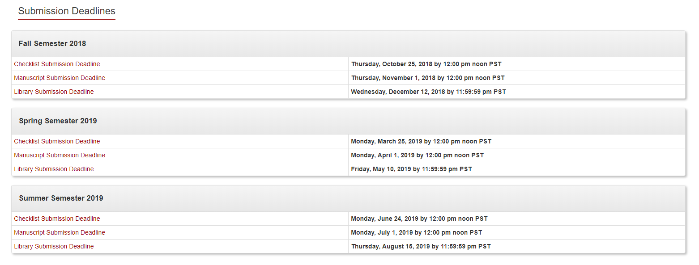
Graduation Deadlines and Degree Dates:
All PhD Courses, Units, Internships, and Requirements must be completed by these dates
Fall 2018: December 13, 2018
Spring 2019: May 20, 2019
Summer 2019: August 15, 2019
Fall 2020: 12/18/2019 (SIS.D.TERM)

Slide 7

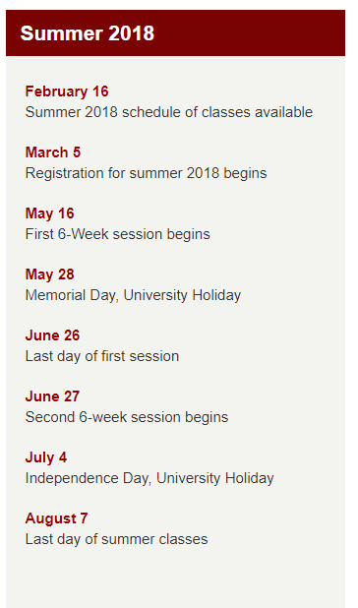
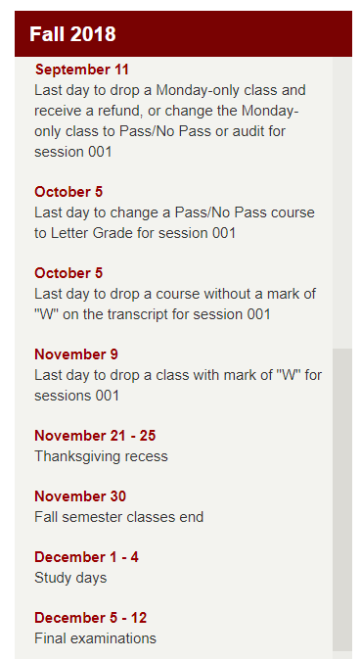
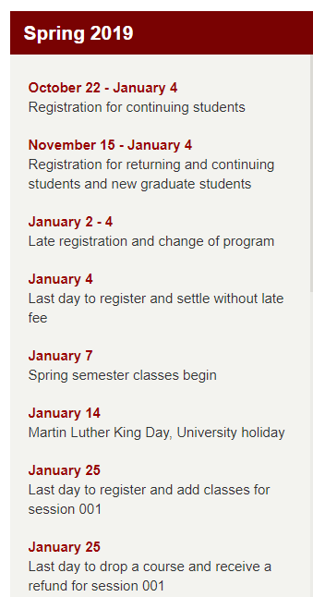
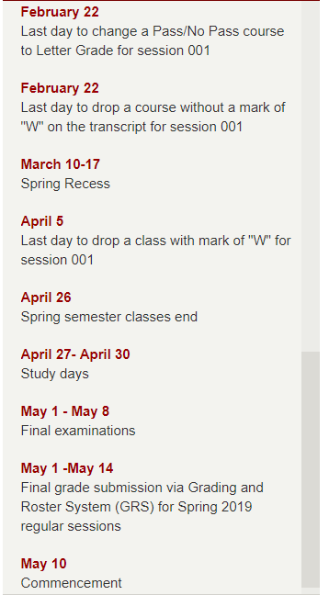

Slide 8
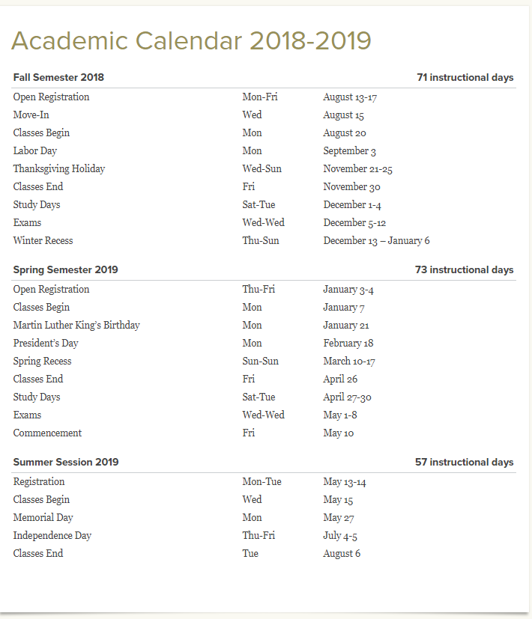

Slide 9
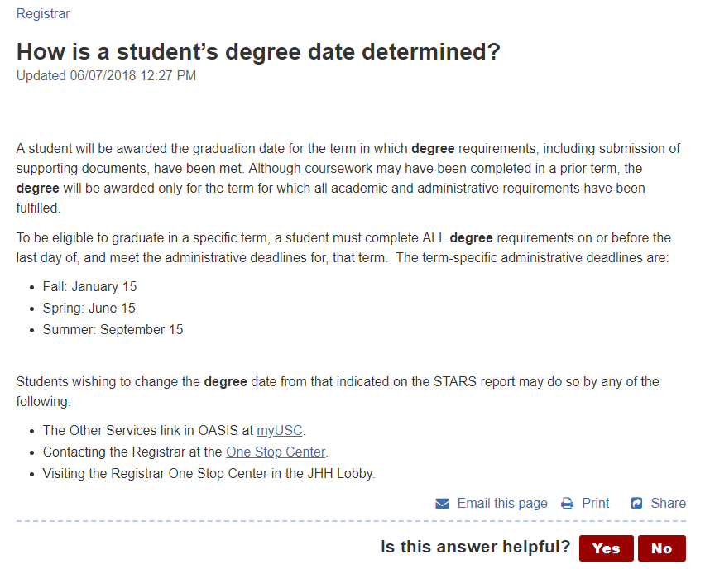

Slide 10
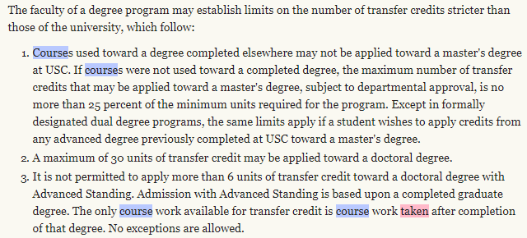
Transfer Credits

Slide 11
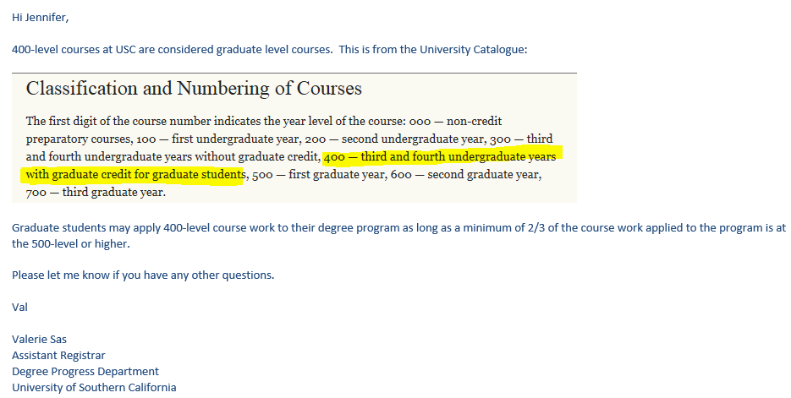
400 level versus 500

Slide 12
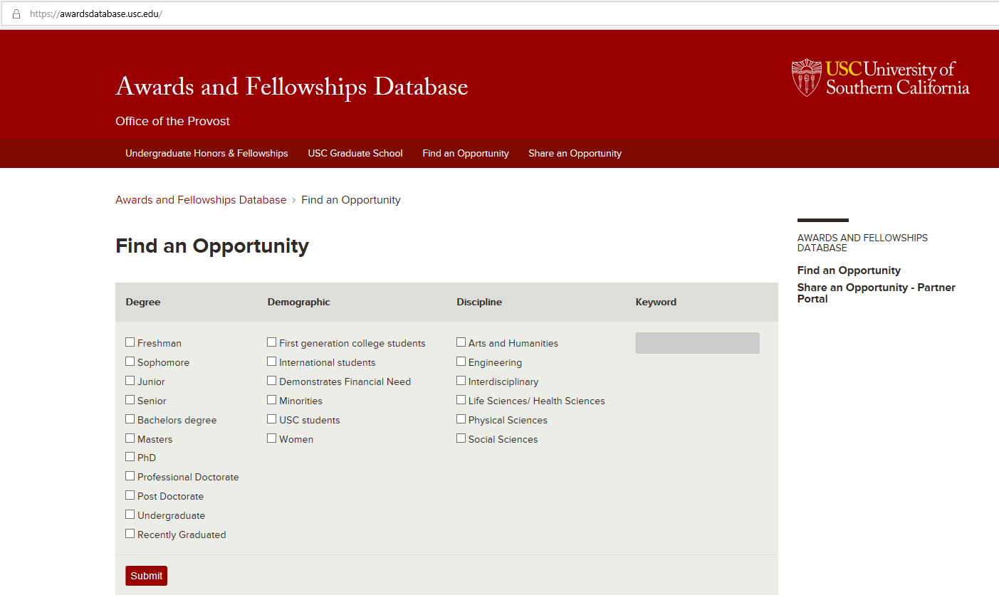

Slide 13
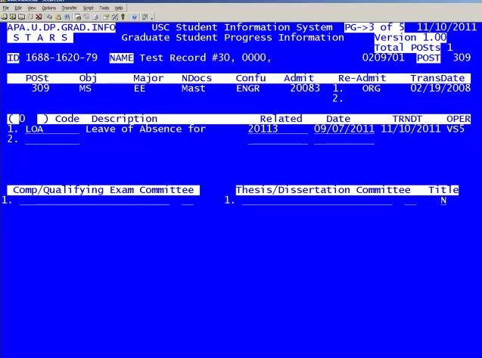
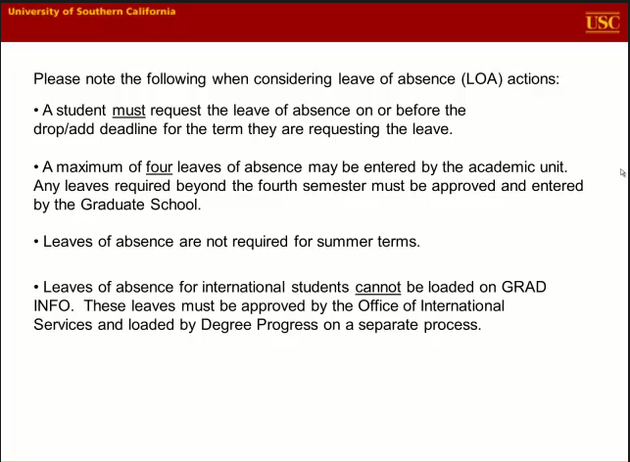

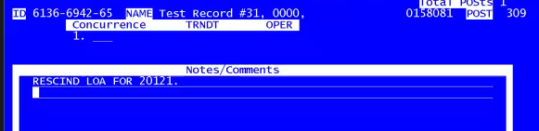
LOA
Must be requested on or before the add/drop date of desired term for LOA.
If the applicant does not request LoA before add/drop date, they must be readmitted and will not be eligible for LOA.
Student must fill out a Department Petition that includes semester requested and clearly listed reason. Dean’s approval will be needed.
If a student rescinds a LOA, makes sure to record this on page 3 using “GRAD COM” and enter on page 4 a comment.
Must be entered into APA.U.DP.GRAD.INFO on page 3

Slide 14
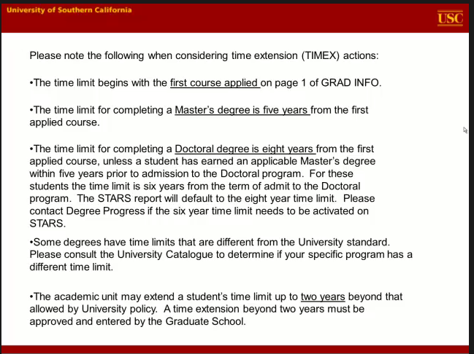
Time Extensions
If over 5 years for Masters or 8 years for PhD
Student must fill out Dornsife College Extension of Time form
A student must be enrolled in all fall and spring terms until they graduate, or they will have to readmit because continuous enrollment has been broken

Slide 15
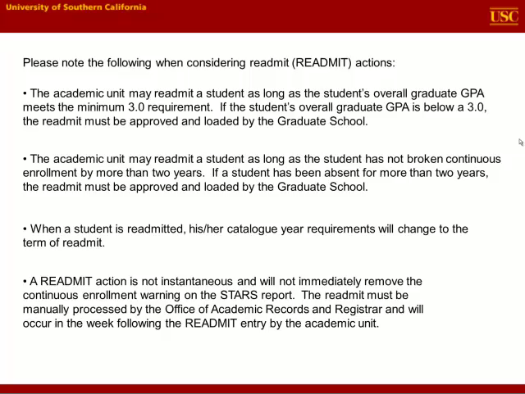
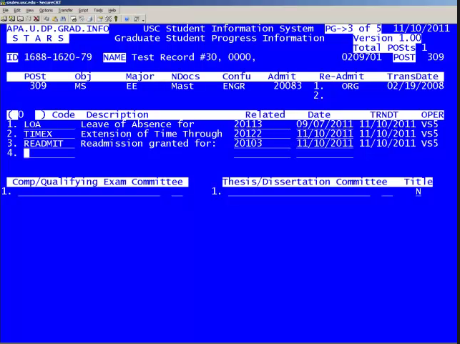
Re-Admits
Have student turn in Department petition
Enter in the Readmit date of when requested.

Slide 16
